Slide 1
Tutorial 5 Group C10
1st October 2018
Joanne Ong

Slide 2
Plans for today
Midterm survey
Pre-mid recap 2: Kahoot
Review: Assignment 2
Exercise 2
Exercise 3
Recursion from Piazza

Slide 3
Notes:
(5 mins) Your feedback will be anonymous to me, but can be seen by the Prof.

Slide 4
Pre-mid recap 2 Kahoot
https://play.kahoot.it/#/k/afc591d5-bc40-48d1-a190-4c3d2b987cca

Slide 5
Pre-mid recap 2 Kahoot
1. 8 bits in 1 byte
2. 2^k values in 1 bit
3. Not ok - method definition after calling it
4. Not ok - return type is `long` even though it should be `void`
5. Ok
6. Not ok – a) comparing int with long, b) no parameter type
7. Not ok – return type of the function should not be long
8. uint32_t (max is (2^16 - 1)^2)
9. 11 (order of evaluation)
10. 4.5 (integer division)
11. De Morgan's Law
12. Nah - the way doubles are represented in computers means that one of them can be 0.30000000 and the other is 0.3000000001 (should do fabs(a - b) < 0.0000001) etc.

Slide 6
Review: Assignment 2
Review Assignment 2 by today and let me know if there are any issues
For future assignments, try to review within 2 days of grading release so that I can update marks if needed
Notes:
(15 mins)

Slide 7
Review: Assignment 2
Correctness of program
Style of program
Marks | Description
0 – 0.5 | Very bad style (Hurts my eyes)
1.0 – 1.5 | Somewhere in the middle (OK lah)
2.0 | Good (Keep it up)

Slide 8
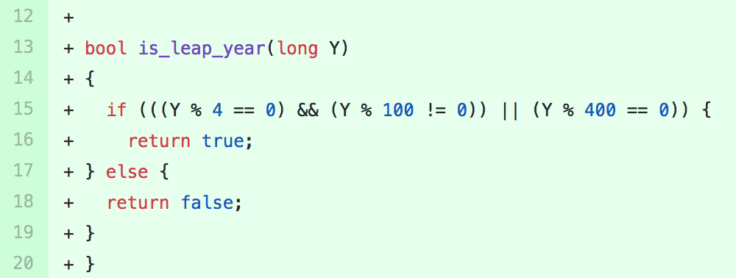
Review: Assignment 2 Stylistic issue: inconsistent indentation

Slide 9
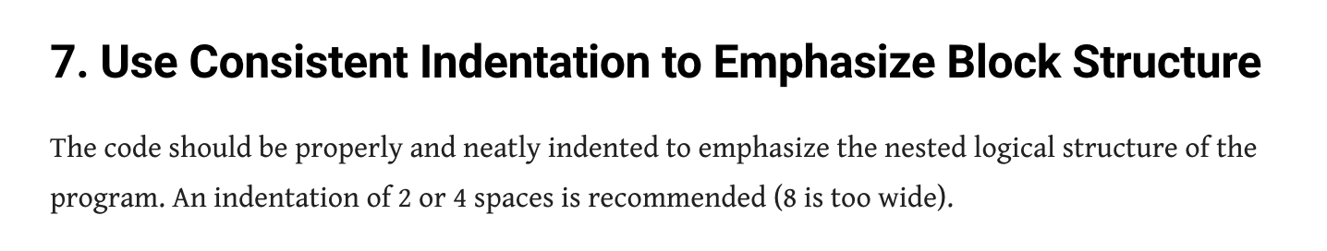
Review: Assignment 2 Stylistic issue: inconsistent indentation

Slide 10
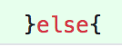

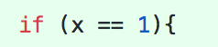
Review: Assignment 2 Stylistic issue: inconsistent spacing

Slide 11
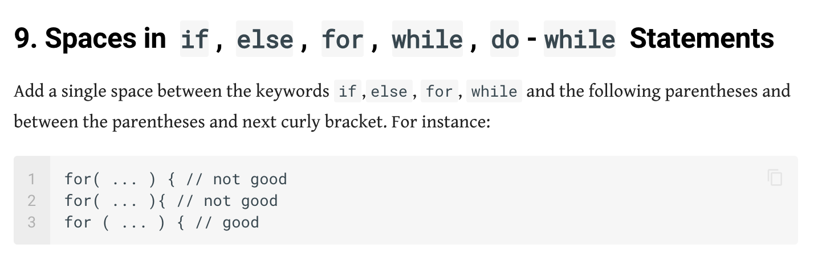
Review: Assignment 2 Stylistic issue: inconsistent spacing

Slide 12
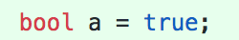
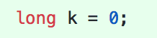
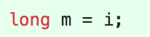
Review: Assignment 2 Stylistic issue: non-descriptive names

Slide 13
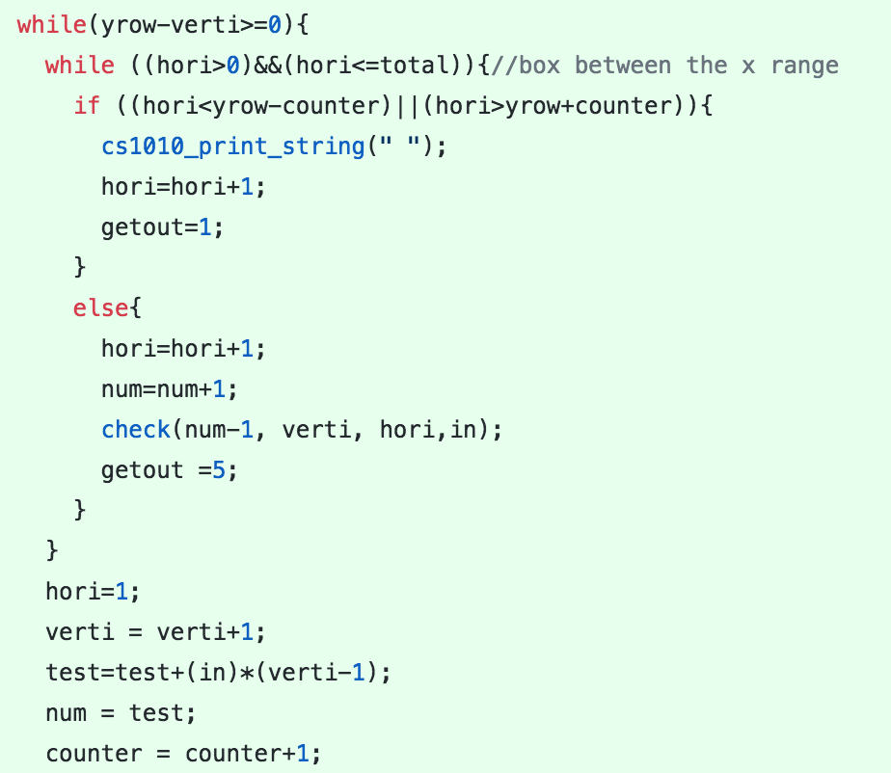
Review: Assignment 2 Stylistic issue: lack of comments
Notes:
Can you tell what this code segment is doing?

Slide 14
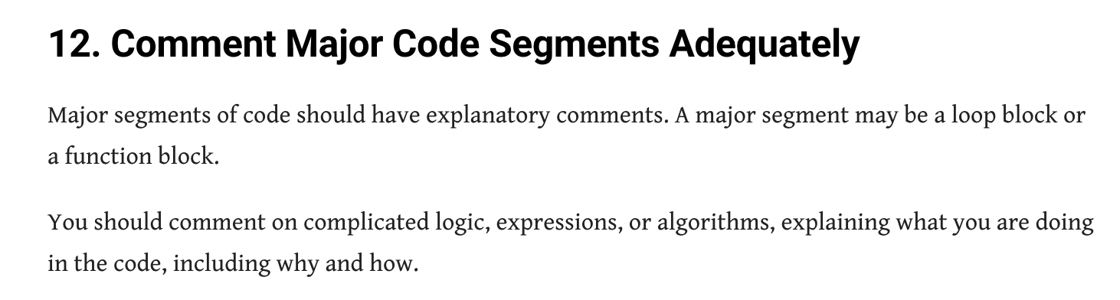
Review: Assignment 2 Stylistic issue: lack of comments

Slide 15
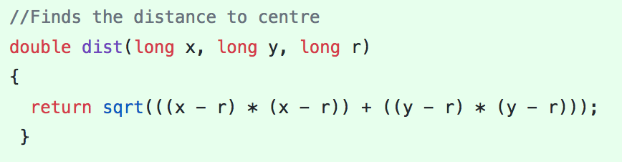
Review: Assignment 2 Stylistic issue: lack of comments
For functions (single line):

Slide 16
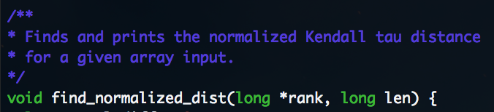
Review: Assignment 2 Stylistic issue: lack of comments
For functions (multiple lines):

Slide 17
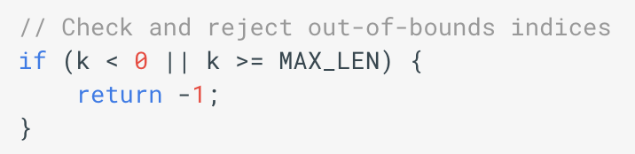
Review: Assignment 2 Stylistic issue: lack of comments
Within function (take note - indentation!):

Slide 18
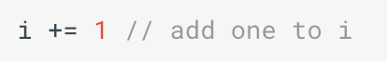
Review: Assignment 2 Stylistic issue: lack of comments
But please do not spam comments:

Slide 19
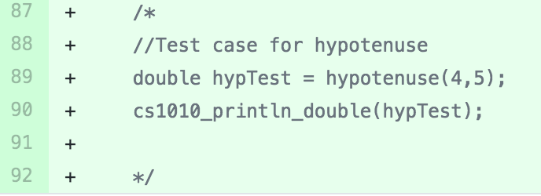
Review: Assignment 2 Stylistic issue: useless commented code
Notes:
Please clean up your code!

Slide 20
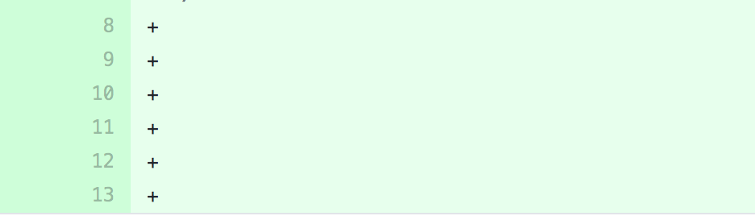
Review: Assignment 2 Stylistic issue: excessive blank lines
Too many blank lines before, after, and in the program!

Slide 21
Review: Assignment 2
Getting full marks is not impossible
Someone in the class got full marks

Slide 22
Review: Assignment 2 pattern.c
Everyone did quite well for this
Key to solving: break the problem into smaller problems
Anyone needs help?

Slide 23
Exercise 2 Q2: Ordinal Suffix
Next 15 mins:
1. Work on ex02 Q2 (ordinal suffix)
2. Edit your style
Ask me if you need help
Notes:
(30 mins)

Slide 24
Exercise 2 Q2: Ordinal Suffix
Next 15 mins:
1. Someone share their code
2. How did you come up with this?
- what variables are needed?
- break problem down
3. Anyone else with different ways?
Notes:
(30 mins)

Slide 25
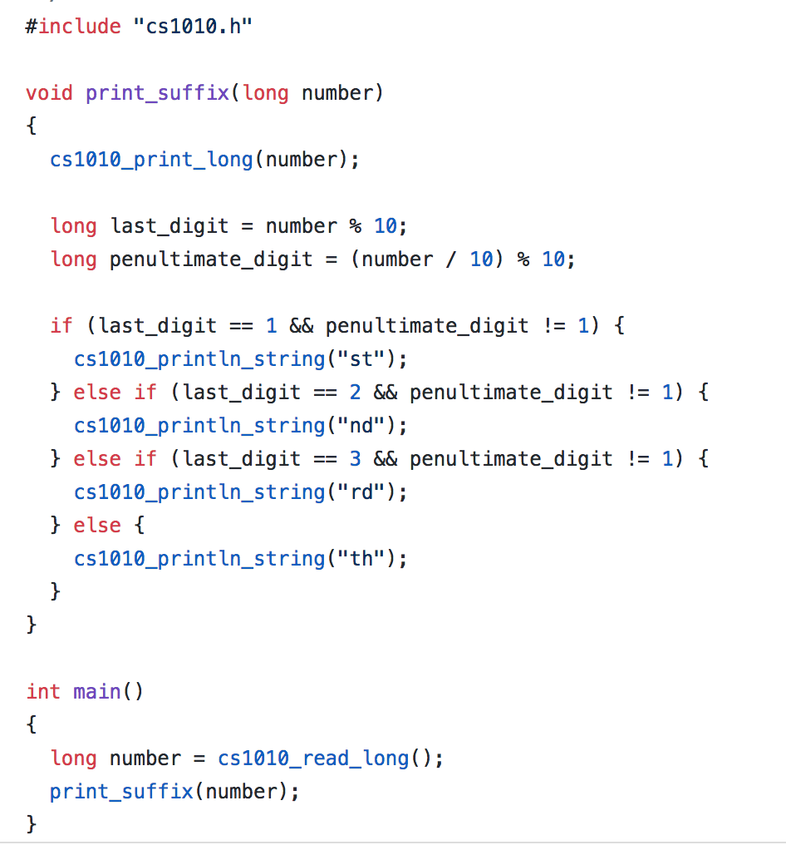
Exercise 2 Q2: Ordinal Suffix

Slide 26
Exercise 3
Next 15 mins:
1. Decide on a question (in-class)
- binary
- rectangle
- fibbonacci
- prime
2. Edit your style
Ask me if you need help
Notes:
(30 mins)

Slide 27
Exercise 3
Next 15 mins:
1. Someone share their code
2. How did you come up with this?
- what variables are needed?
- break problem down
3. Anyone else with different ways?
Notes:
(30 mins)

Slide 28
Recursion from Piazza
Notes:
(15 mins)
Anyone has any ideas?

Slide 29
Recursion from Piazza
B
A
ne(1, 3)
Notes:
(15 mins)
When you see a bigger problem like this, you can try to use wishful thinking. So what do I mean?

Slide 30
Recursion from Piazza
B
A
ne(1, 1)
Notes:
(15 mins)
Imagine you have already reached here. How many paths are there from the red point to B? (2 paths – either north or east).

Slide 31
Recursion from Piazza
B
A
ne(1, 1) = ne(0, 1) + ne(1, 0)
Notes:
(15 mins)
From here, can you determine the pattern?

Slide 32
Recursion from Piazza
B
A
ne(x, y) = ne(x - 1, y) + ne(x, y - 1)
Notes:
(15 mins)
From here, you can already construct the recurrence relation.

Slide 33
Recursion from Piazza
long ne (long x, long y) {
return ne(x - 1, y) + ne(x, y - 1);
}
Notes:
So now you have this. But what is the problem here? (It does not terminate nor return any value)
We need base cases.

Slide 34
Recursion from Piazza
B
A
ne(0, 0)
Notes:
(15 mins)
Imagine you have already reached here. How many paths are there from the red point to B? (1 path)
Where else can you be?

Slide 35
Recursion from Piazza
B
A
ne(0, 1)
Notes:
(15 mins)
Imagine you have already reached here. How many paths are there from the red point to B? (1 path)
Where else can you be?

Slide 36
Recursion from Piazza
B
A
ne(1, 0)
Notes:
(15 mins)
Imagine you have already reached here. How many paths are there from the red point to B? (1 path)
Where else can you be?

Slide 37
Recursion from Piazza
long ne (long x, long y) {
???
return ne(x - 1, y) + ne(x, y - 1);
}
Notes:
What do you think the base case should be?

Slide 38
Recursion from Piazza
long ne (long x, long y) {
if (x == 0 || y == 0) {
return 1;
}
return ne(x - 1, y) + ne(x, y - 1);
}

